Slide 1
USING ASSESSMENTS IN LCMS+
In- and Outside of the Classroom

Slide 2
Session Objectives
By the end of the session, users will be able to:
Create assessments at course and event levels
Assign assessments to students and/or groups of students
Provide students with a link to assessments via lesson presentation (i.e. PowerPoint, Nearpod, etc.)
Access and track student performance and submission information
Populate the course gradebook with assessment results and provide timely feedback

Slide 3
Creating a link to Assessment
Providing students with links to assessments in LCMS+
Option 1: Provide a direct link to the Event with the assessment
available in the PPT or Nearpod presentation.
Each Event page has its own URL link.
This link can be embedded into the presentation at any point.
Students can use the link to navigate DIRECTLY to the Event to
access the assessment.

Slide 4
Quiz Link
This will take you to the Event with the assessment.

Slide 5
Option 2: Students can Use the Exam Portal in LCMS+ to link directly to the assessment in the PPT or Nearpod presentation.
All assessments are accessible through the Exam Portal.
Provide students a direct link to LCMS+ from PPT or Nearpod.
Students choose the ‘Exams’ link on the Curriculum Portal login page.
When students login using their Okey credentials, it takes them directly to the Exam portal to their list of available assessments.

Slide 6
Quiz Link
This will take you to the LCMS+ login page where the Exam Portal can be accessed.

Slide 7
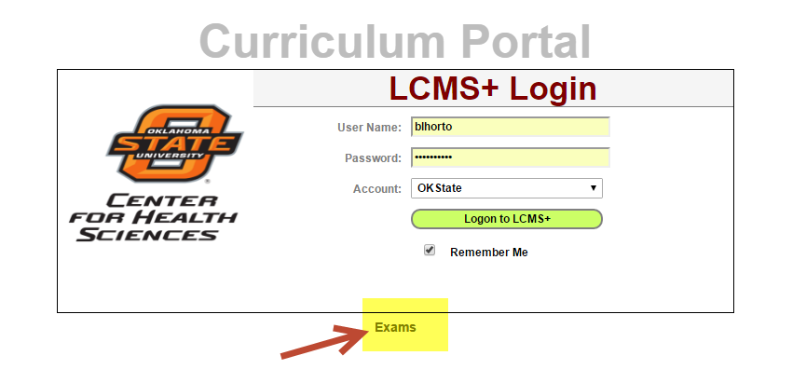
Quiz Link

Slide 8
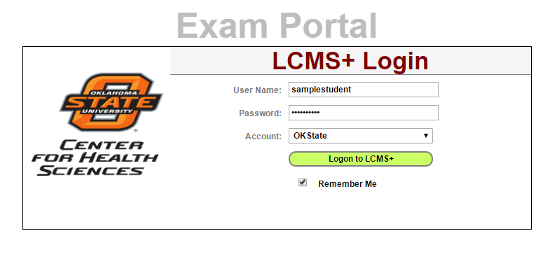

Slide 9
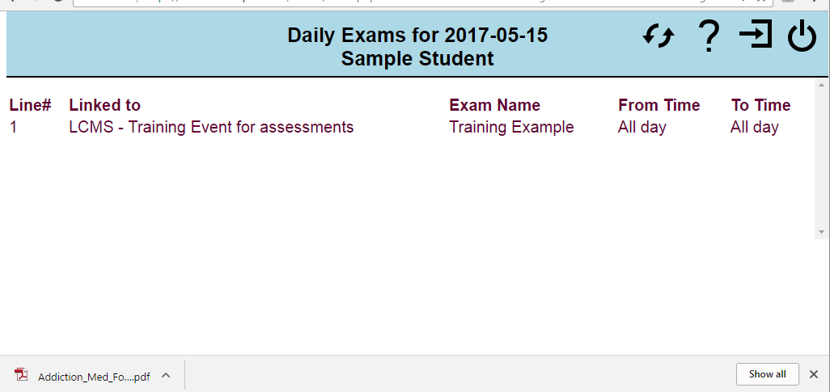
Student clicks on the Title and is sent directly to the assessment.

Slide 10
Option 3: Provide the direct link to the assessment via the Event or Exam Portal in other ways
Examples:
Send students the link in an Announcement
Send students the link in an email
Provide the link in a course materials document

Slide 11
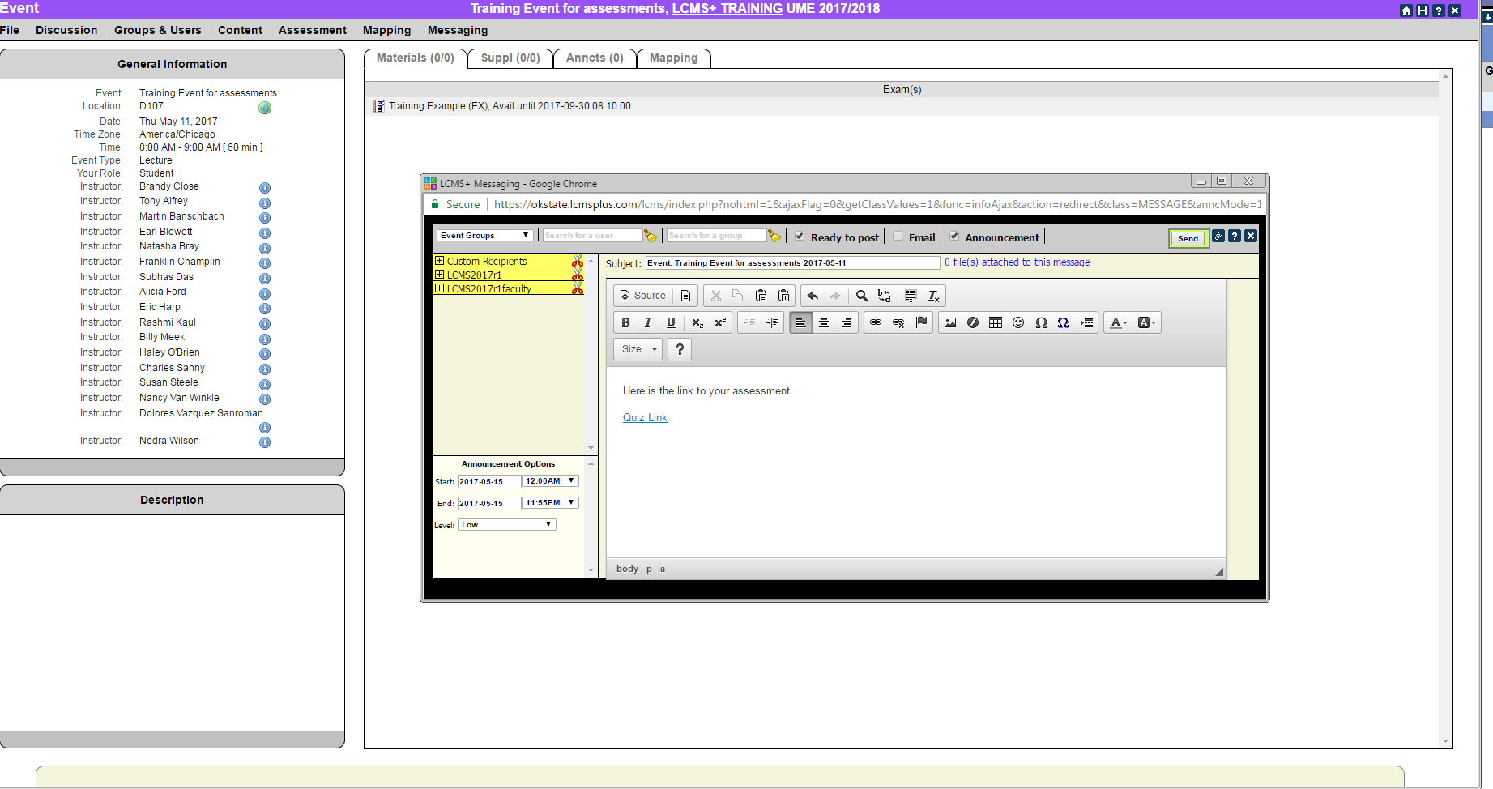

Slide 12
Accessing Student Assessment Submissions
Step 1: Access the Event with the Assessment
Step 2: Choose ‘Assessment’ along the top and click “Exam Manager”
Step 3: Click the Responses link for the assessment
Step 4: Click “(re)Evaluate” along the top each time before exporting to the gradebook
Step 5: Click ‘Gradebook’ link along the top- Choose Category if available- Export to ScoreCard
Step 6: Provide feedback (i.e. comments)

Slide 13
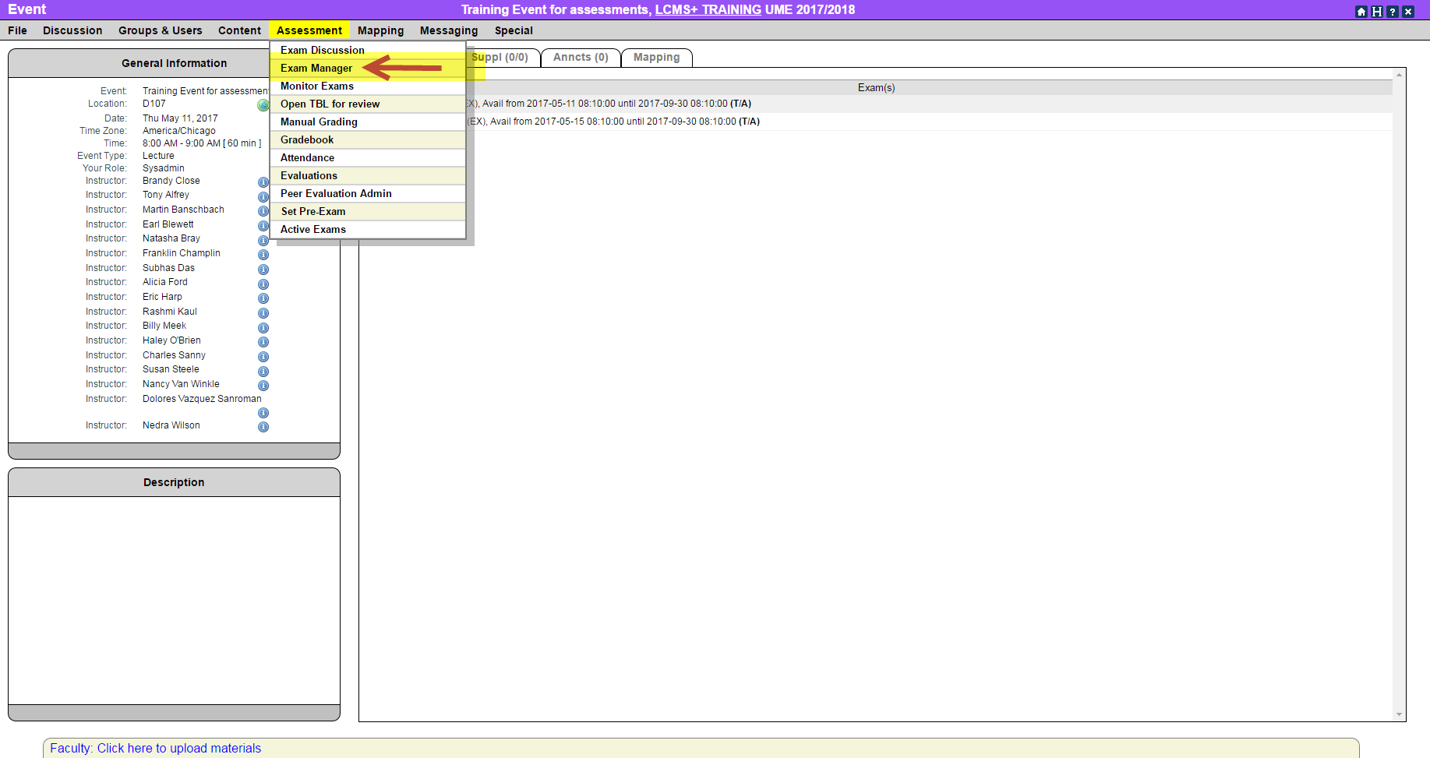
Step 1: Access the Event with the Assessment
Step 2: Choose ‘Assessment’ along the top and click “Exam Manager”

Slide 14
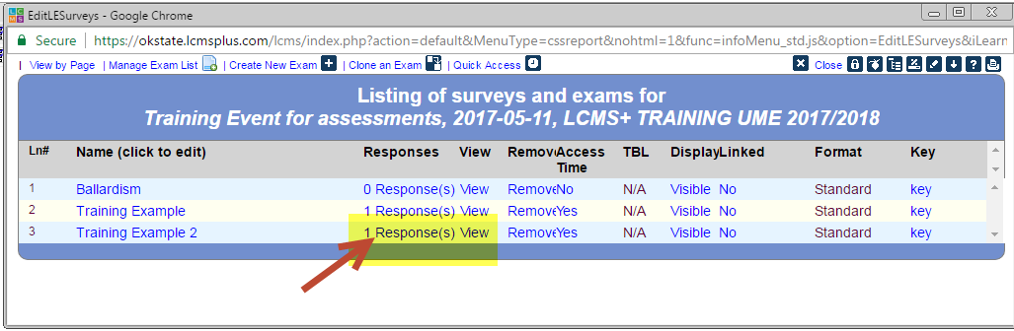
Step 3: Click the Responses link for the assessment

Slide 15
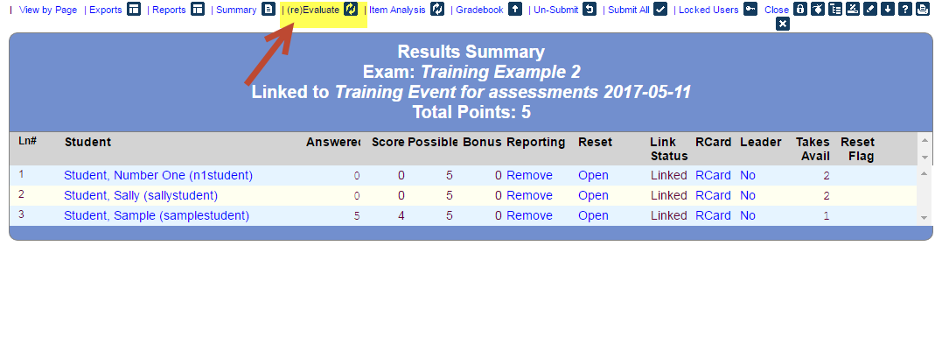
Step 4: Click “(re)Evaluate” along the top each time before exporting to the gradebook

Slide 16
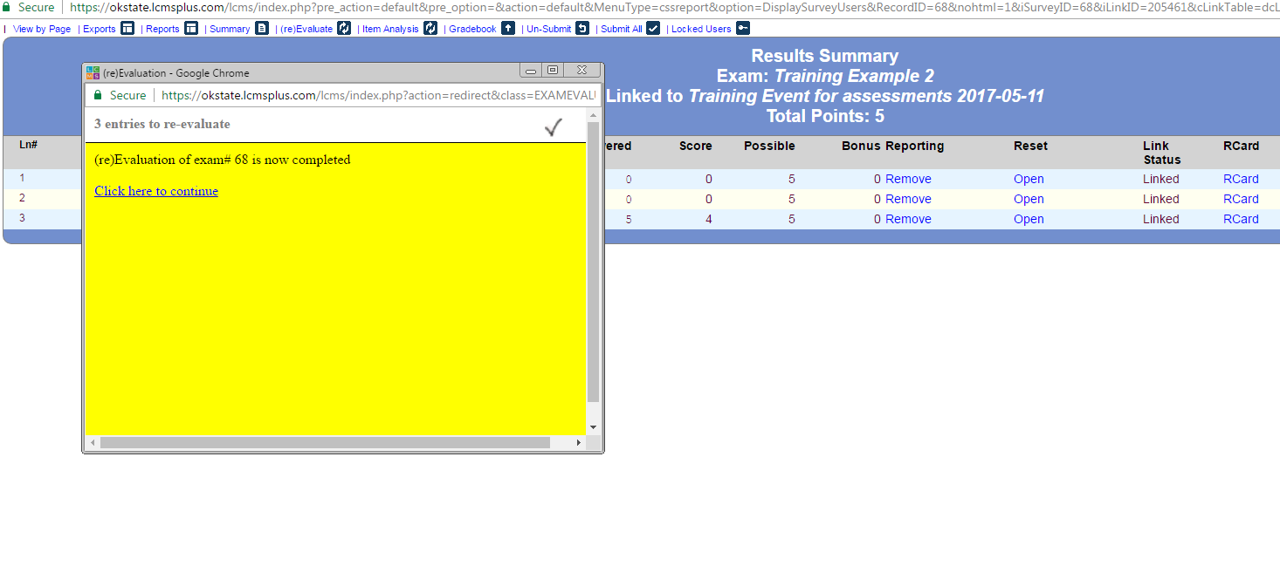

Slide 17
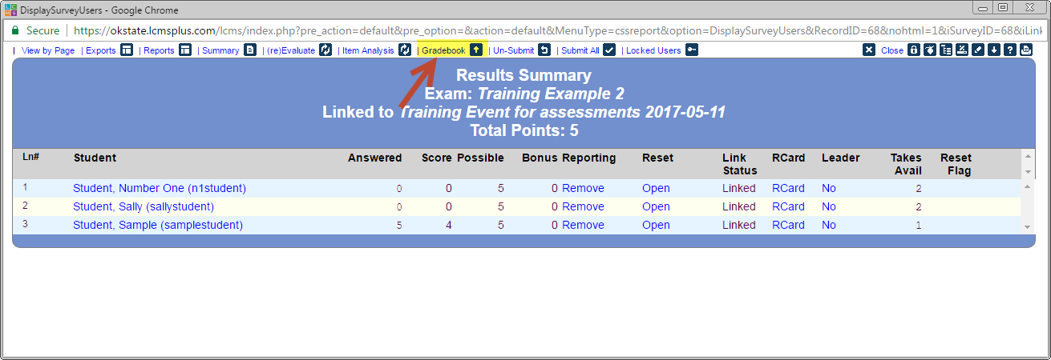
Step 5: Click ‘Gradebook’ link along the top- Choose Category if available- Export to ScoreCard

Slide 18
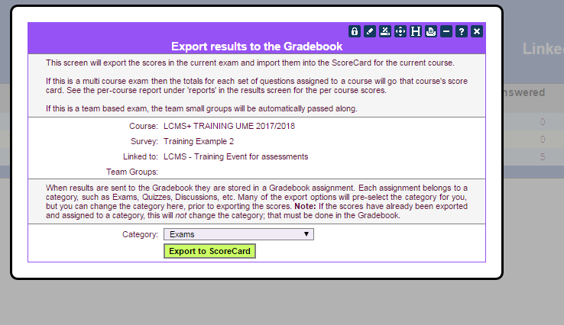
Choose Open Gradebook

Slide 19
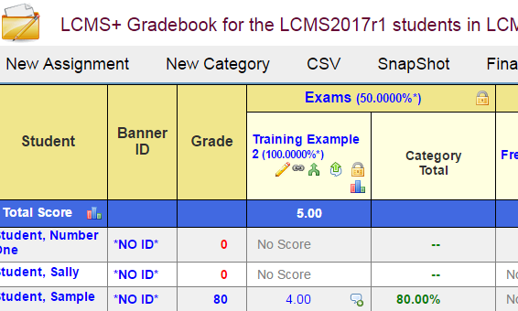

Slide 20
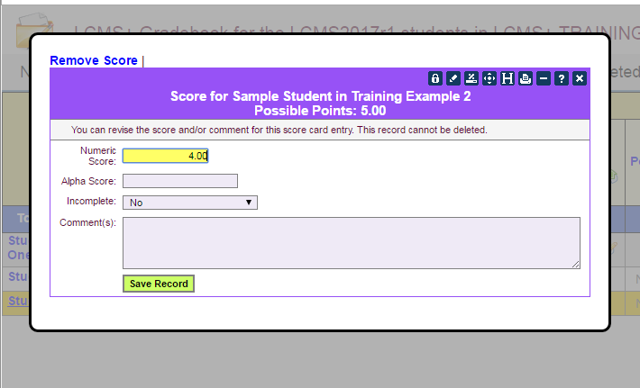
Step 6: Provide feedback (i.e. comments)- Click Save Record

Slide 21
QUESTIONS??
Please contact me at brandy.close@okstate.edu
if you have any questions.

